Slide 1

Setting up your goal
When to change
dev/test sets and
metrics
deeplearning.ai

Slide 2
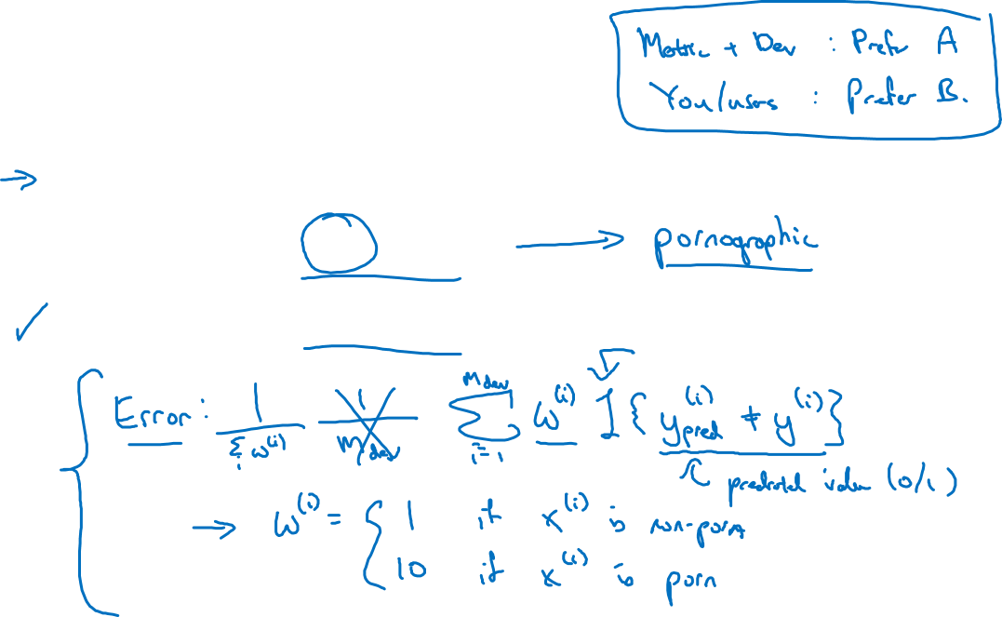
Cat dataset examples
Metric: classification error
Algorithm A: 3% error
Algorithm B: 5% error

Slide 3

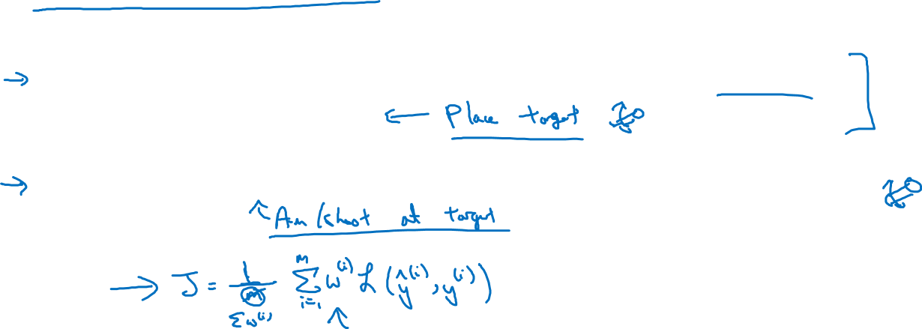
Orthogonalization for cat pictures: anti-porn
So far we’ve only discussed how to define a metric to evaluate classifiers.
2. Worry separately about how to do well on this metric.

Slide 4

Another example
Algorithm A: 3% error
Algorithm B: 5% error
Dev/test
User images
If doing well on your metric + dev/test set does not
correspond to doing well on your application, change your
metric and/or dev/test set.

Slide 5
Main Points
If doing well on your metric + dev/test set does not correspond to doing well on your application, change your metric and/or dev/test set.

